Slide 1
Machine Learning in Computer Vision
Last updated: 10-11-2024
Gonzalez R. C., Woods R. E., Eddins S. L., Digital Image Processing Using Matlab, Pearson Education, 1st edition, 2007. (Ch. 12)
Gonzalez R. C., Woods R. E., Eddins S. L., Digital Image Processing, Pearson Education, 3rd edition, 2007. (Ch. 12)
Szeliski R., Computer Vision - Algorithms and Applications, Springer, 2nd Edition, 2022. (Ch. 5)
Dr. Zulfiqar Habib, Professor
http://vig.cuilahore.edu.pk

Slide 2
Common Approach
Model Generation
Models
Training
Testing
Image acquisition
Preprocessing
Segmentation
Feature extraction
Classification / Regression
/ Clustering
Problem domain
Knowledge base
Result

Slide 3
Machine Learning
Machine learning (ML) is a subset of artificial intelligence which provides machines the ability to learn automatically and improve the experience without being explicitly programmed.
Supervised Learning implies we are given a training set of (X, Y) pairs by a “teacher”
Unsupervised Learning means we are only given the Xs and some (ultimate) feedback function on our performance.
Reinforcement Learning is all about taking suitable action to maximize reward in a particular situation. It is employed by various software and machines to find the best possible behavior or path it should take in a specific situation.
Notes:
Reinforcement Learning: Interactive demo (https://spimelab.com/learn/rl/test.html)

Slide 4
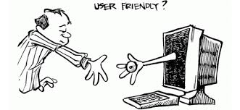
Machine Learning in Computer Vision… Basic Requirements
Access to imaging hardware for digital Image acquisition
Highly efficient: Input and output have to be fast, efficient, and machine independent
Code to be optimized to make sure the use of all processing cores of GPU
Code to be re-usable across the systems: Computer vision and image analysis modules should be as independent as possible from the final applications
User-friendly interface
Use of bench-mark and separate data sets for the training and testing of proposed modal. Is it sufficient?
Notes:
http://gim.unmc.edu/dxtests/roc3.htm
1999-Paulus
Rahman, Shah Atiqur, et al. "Fast action recognition using negative space features." Expert Systems with Applications 41.2 (2014): 574-587.
Paulus, Dietrich, Joachim Hornegger, and Heinrich Niemann. "Software engineering for image processing and analysis." Handbook of computer vision and applications 3 (1999): 77-103.

Slide 5
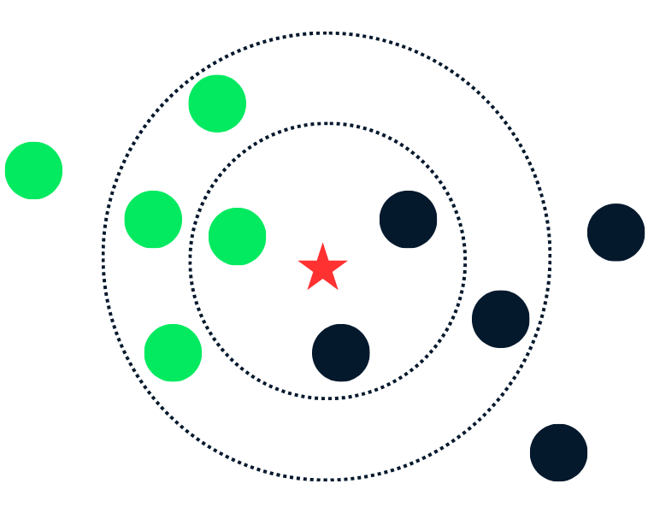
Traditional Handcrafted Approaches K Nearest Neighbor (KNN)
KNN is a simple and versatile algorithm used in supervised machine learning for classification and regression tasks. It works on the principle that data points close together tend to share similar characteristics.
During the training phase, KNN stores all the available data. When a new data point arrives, it finds the K nearest neighbors in the training data and predicts the class label or value of the new data point based on the majority vote of its neighbors.
Notes:
In K-Nearest Neighbors (KNN), the parameter K (number of nearest neighbors) is chosen to control the model's performance. Here’s how K is generally estimated:
Empirical Testing: Commonly, different values of K are tested (like 1, 3, 5, 7, etc.), and the one giving the best accuracy or lowest error on validation data is chosen.
Cross-Validation: Cross-validation, especially k-fold cross-validation, is used to find the optimal K by checking performance on various subsets of data.
Odd Values for Classification: If the task is classification, odd values of K are often preferred to avoid ties in voting.
Rule of Thumb: A basic rule is to start with K around the square root of the total number of data points, then adjust as needed.
A good K balances bias (underfitting) and variance (overfitting) for reliable predictions.

Slide 6
Traditional Handcrafted Approaches Support Vector Machine (SVM)
SVM is a supervised machine learning algorithm and can be used for both classification or regression challenges. However, it is mostly used in classification problems.
SVM works by mapping data to a high-dimensional feature space so that data points can be categorized, even when the data are not otherwise linearly separable. A separator between the categories is found, then the data are transformed in such a way that the separator could be drawn as a hyperplane.

Slide 7
Limitations of Traditional Handcrafted Approaches
Handcrafted approach requires expert designed feature detectors, descriptors, and encoding/vocabulary building methods for feature extraction and representation.
Feature engineering is important but labor-intensive and requires expertise of the subject matter.
There are no universally best handcrafted feature descriptors for all datasets/domains.
Notes:
Feature engineering is the process of transforming raw data into meaningful features (variables or attributes) that improve the performance of machine learning models. It involves selecting, modifying, or creating new features to make patterns in the data more visible to the model. Good features can make a big difference in model accuracy and are essential for effective machine learning.

Slide 8

Application… Modern Approaches…
Example: Human Action Recognition
Deep Learning
Good features are learned automatically using a general purpose learning procedure
Yann LeCun, Yoshua Bengio, Geoffrey Hinton, Deep Learning, Nature, Vol. 521, pp. 436-444, 2015.
Notes:
Deep learning (also known as deep structured learning or hierarchical learning) is part of a broader family of machine learning methods based on learning data representations, as opposed to task-specific algorithms. Learning can be supervised, semi-supervised or unsupervised.
RNN (recurrent neural networks) is a class of artificial neural network where connections between nodes form a directed graph along a sequence.
Neural networks is a generic name for a large class of machine learning algorithms, including but not limited to: perceptrons, Hopfield networks, Boltzmann machines, fully connected neural networks, convolutional neural networks, recurrent neural networks, long short term memory neural networks, autoencoders, deep belief networks, generative adversarial networks and many more. Most of them are trained with an algorithm called backpropagation.
In the late eighties, early to mid nineties, the dominating algorithm in neural nets (and machine learning in general) was fully connected neural networks and still if you say simply a neural net, people might think that you are talking about a fully connected network. Those types of networks have a large number of parameters, and so do not scale well. Here comes convolutional neural networks which could be considered essentially a not fully connected neural nets (each neuron is connected to only a few neurons in the previous layer) and neurons share weights. These type of networks have been proven successfully especially in the fields of computer vision and natural language processing, where they broke every record. The success of convolutional neural networks was the main reason why neural nets (now called deep learning) has become such a hot topic in the last 5 years.
It is clear that the learning speed of feedforward neural networks including deep learning is in general far slower than required and it has been a major bottleneck in their applications for past decades. Two key reasons behind may be: 1) the slow gradient-based learning algorithms are extensively used to train neural networks, and 2) all the parameters of the networks are tuned iteratively by using such learning algorithms.
http://www.nature.com/nature/journal/v521/n7553/pdf/nature14539.pdf
http://www.cs.nyu.edu/~yann/talks/lecun-20080409-google.pdf

Slide 9
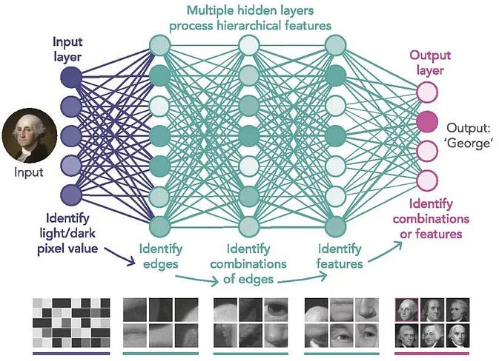
Application… Modern Approaches…
Deep Learning
Learn hierarchical representations of features, capturing complex patterns and relationships in the data

Slide 10
Comparison… Traditional Handcrafted Vs. Deep Learning
Handcrafted Approach | Deep Learning Approach
It requires manual feature extraction/engineering | Deep learning can automatically learn features in data.
Feature extraction for unstructured data is very difficult. | Deep learning is largely a “black box "technique, updating learning weights at each layer.
It requires subject-matter expertise to extract key features. | Deep learning extracts features automatically from domain-specific images, without any feature engineering technique.

Slide 11
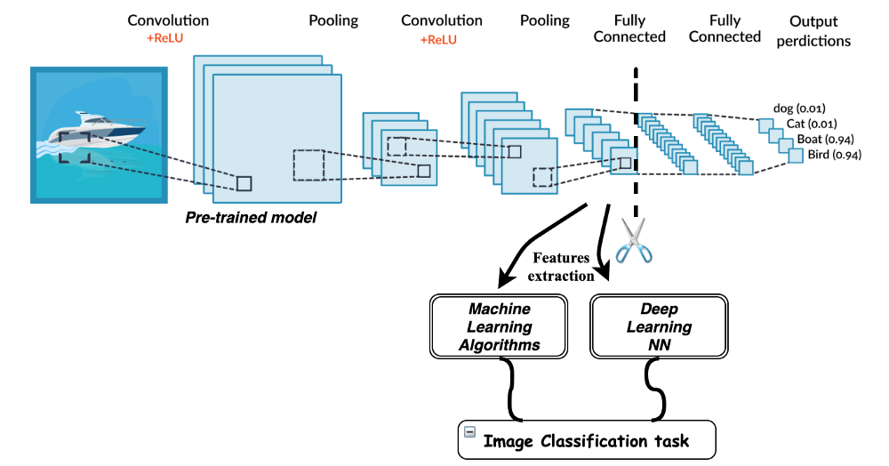
Machine Learning… Modern Approaches
Transfer Learning
The ability of deep learning to extend what has been learned in one context to new context
Notes:
https://mc.ai/transfer-learning-with-deep-learning-machine-learning-techniques/
Rectified Linear Unit (ReLU): is a piecewise linear function that will output the input directly if is positive, otherwise, it will output zero. It has become the default activation function for many types of neural networks because a model that uses it is easier to train and often achieves better performance.

Slide 12
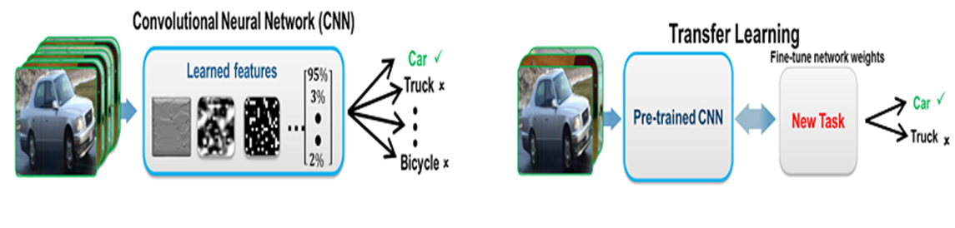
Comparison… CNN Vs. Transfer Learning
CNN using IMAGENET |  | Transfer learning
Training data | Millions of labeled images | Training data | 100s to 1000s images
Computation | Intensive | Computation | Moderate
Training Time | Days to weeks | Training Time | Seconds to minutes
Model Accuracy | High | Model Accuracy | Good (depends on the pre-trained CNN model)

Slide 13
Machine Learning… Modern Approaches
How much modern machine learning techniques are inspired from biological learning?
Notes:
While modern machine learning techniques are inspired by biological learning, it's important to note that they are not exact replicas of biological systems. Instead, they selectively borrow ideas and principles from biology to develop computational models that are effective for solving specific tasks in artificial intelligence. Additionally, many machine learning techniques have evolved independently of biological inspiration, driven primarily by mathematical and computational considerations.

Slide 14
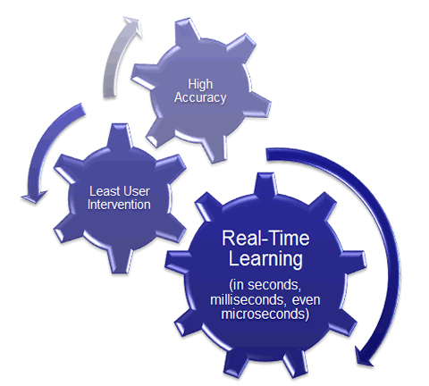
Machine Learning… Modern Approaches: ELM
Extreme Learning Machine
ELM not only achieves state-of-the-art results but also shortens the training time from days (spent by deep learning) to several minutes (by ELM).
http://www.ntu.edu.sg/home/egbhuang/
ELM is a Single-Hidden Layer Feedforward Networks (SLFNs)
Notes:
Filling the gap between single hidden layer of learning and multi-hidden-layer of learning
ELM is a Single-Hidden Layer Feedforward Networks (SLFNs)
Do we really need to train multi hidden layers of feedforward networks by iteratively adjusting hidden neurons? Should feedforward neural networks be considered as a blackbox as considered in the past six decades?
Different from BP and SVM which consider multi-layer of networks as a black box, ELM handles both SLFNs and multi-hidden-layer of networks similarly. ELM considers multi-hidden-layer of networks as a white box and trained layer-by-layer. However, different from Deep Learning which requires intensive tuning in hidden layers and hidden neurons, ELM theories show that hidden neurons are important but need not be turned (for both SLFNs and multi-hidden-layer of networks) , learning can simply be made without iteratively tuning hidden neurons.
Different from Deep Learning, all the hidden neurons in hierarchical ELM as a whole are not required to be iteratively tuned.
http://www.ntu.edu.sg/home/egbhuang/
Xia Liu, Shaobo Lin, Jian Fang, and Zongben Xu, Is Extreme Learning Machine Feasible? A Theoretical Assessment (Part I), IEEE Transactions on Neural Networks and Learning Systems, Vol. 26, No. 1, 2015.

Slide 15
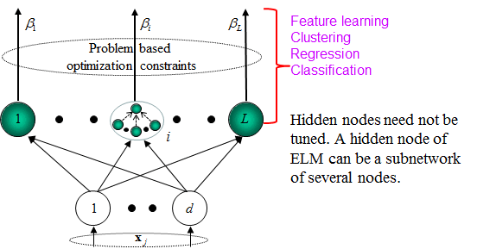
Machine Learning… Modern Approaches: ELM
Filling the gap between machine learning and biological learning
Notes:
http://www.ntu.edu.sg/home/egbhuang/

Slide 16
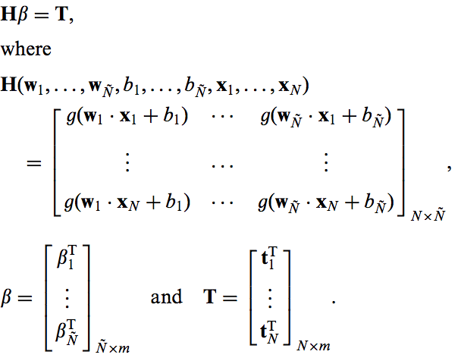
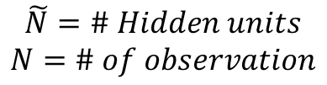
Machine Learning… Modern Approaches: ELM
Does ELM allow to build a deep, hierarchical system that learn good features on its own?
Notes:
ELM does not allow to build a deep, hierarchical system that learn good features on its own.
ELM is a type of machine learning algorithm used for supervised learning tasks, particularly in the context of neural networks. However, ELMs are not typically associated with building deep, hierarchical systems that learn features on their own.
ELMs are known for their simplicity and efficiency, particularly in training single-hidden-layer feedforward neural networks. Unlike traditional backpropagation algorithms, ELMs randomly initialize the weights connecting the input layer to the hidden layer, and then analytically determine the weights of the output layer based on the training data. This leads to fast training times and good generalization performance.
While ELMs can be used to train shallow neural networks effectively, they are not designed for building deep, hierarchical systems. Deep learning architectures, such as deep neural networks (DNNs), convolutional neural networks (CNNs), or recurrent neural networks (RNNs), are specifically designed to learn hierarchical representations of data by stacking multiple layers of neurons.
In deep learning, each layer of the network learns increasingly abstract features from the input data, allowing for the automatic extraction of high-level representations. This hierarchical learning process is a key advantage of deep learning architectures, enabling them to excel in tasks such as image recognition, natural language processing, and speech recognition.
While ELMs are efficient for shallow learning tasks, they lack the capacity for building deep hierarchical systems that can automatically learn complex features from data. For tasks requiring hierarchical feature learning, deep learning architectures are generally preferred due to their ability to learn hierarchical representations in an end-to-end manner.

Slide 17
Machine Learning… Modern Approaches: GAN
In generative adversarial network (GAN), two opposing neural networks generative (deconvolutional) and discriminative (convolutional) contest with each other in a game. Through backpropagation, the discriminator's classification provides a signal that the generator uses to update its weights.
The generative model is like “a team of counterfeiters, trying to produce and use fake currency” while the discriminative model is like “the police, trying to detect the counterfeit currency”. The generator is trying to fool the discriminator while the discriminator is trying to not get fooled by the generator. As the models train through alternating optimization, both methods are improved until a point where the “counterfeits are indistinguishable from the genuine articles”.
Notes:
https://en.wikipedia.org/wiki/Generative_adversarial_network

Slide 18
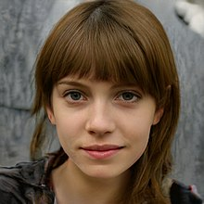
Machine Learning… Modern Approaches: GAN
Given a training set, this technique learns to generate new data with the same statistics as the training set. For example, a GAN trained on photographs can generate new photographs that look at least superficially authentic to human observers, having many realistic characteristics.
Though originally proposed as a form of generative model for unsupervised learning, GANs have also proven useful for semi-supervised learning, fully supervised learning, and reinforcement learning.
An image generated by a StyleGAN that looks deceptively like a photograph of a real person. This image was generated by a StyleGAN based on an analysis of portraits.

Slide 19
Machine Learning… Modern Approaches: GAN - Applications
Fashion, art and advertising
Video games
Reconstruction of 3D models of objects from images
Age face photographs to show how an individual's appearance might change with age
Data augmentation
Generative AI for new content, such as text (Large Language Model), images, videos or music.
And many more…
https://en.wikipedia.org/wiki/Generative_adversarial_network
Notes:
Generative AI refers to artificial intelligence systems that create new content, such as text, images, or music, by learning patterns and structures from existing data.
https://youtube.com/playlist?list=PLPTV0NXA_ZSgsLAr8YCgCwhPIJNNtexWu&si=tDbYgEKGXZmIaQtK
Large Language Model (LLM), a subset of Generative AI is an advanced AI system trained on massive text datasets to understand and generate human-like text for a wide range of tasks, including summarization, translation, and answering questions.

Slide 20
Machine Learning… Modern Approaches
Vision Transformers (ViTs)
Computes relationships among pixels in various small sections of the image (termed attention), at a drastically reduced cost.
Notes:
Multi-Layer Perceptrons (MLP)
Does not need convolution as in CNN
Best performed in NLP
https://en.wikipedia.org/wiki/Vision_transformer

Slide 21
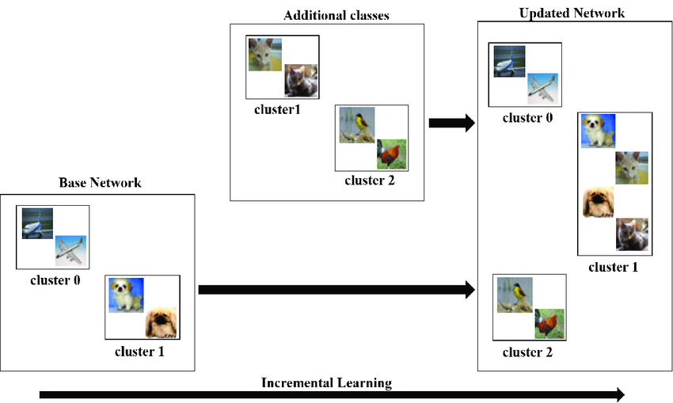
Machine Learning… Modern Approaches
Incremental Learning
Where new data is incrementally added to a model, and the model is retrained on the new data. This allows the model to continuously learn and improve over time.
Notes:
https://www.aiforanyone.org/glossary/incremental-learning#:~:text=Incremental%20learning%20is%20a%20method,improve%20its%20performance%20over%20time.

Slide 22
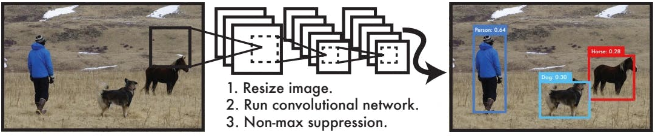
Machine Learning… YOLO
is a real-time object detection algorithm, based on CNN, that detects objects in images and videos by dividing the image into a grid of cells and predicting the presence of objects and their bounding boxes.
You Only Look Once
DEMO
Notes:
https://cocodataset.org/
COCO is a large-scale object detection, segmentation, and captioning dataset. COCO has several features:
Object segmentation
Recognition in context
Superpixel stuff segmentation
330K images (>200K labeled)
1.5 million object instances
80 object categories
91 stuff categories
5 captions per image
250,000 people with keypoints
https://encord.com/blog/yolo-object-detection-guide/

Slide 23
Feature Extraction Using Machine Learning (ML)
It is the process of automatically deriving informative and meaningful features from raw data using ML techniques. This process is essential for transforming raw data into a format that ML algorithms can effectively learn from and make predictions.
Purpose:
The primary purpose of feature extraction with ML models is to capture relevant information from raw data and represent it in a format that facilitates learning and prediction tasks.
ML models require input features that are informative, discriminative, and relevant to the target variable to make accurate predictions.

Slide 24
Types of ML Models for Feature Extraction
Deep Learning Models: Deep learning models, such as convolutional neural networks (CNNs) for image data or recurrent neural networks (RNNs) for sequential data, are capable of automatically learning hierarchical and abstract representations of features from raw data.
Transfer Learning: Transfer learning uses pre-trained models that have learned meaningful features from large datasets. These pre-trained models can be fine-tuned or used as feature extractors for new tasks or domains.
Traditional ML Models: Even traditional ML models like decision trees, random forests, or support vector machines (SVMs) can indirectly perform feature extraction through feature importance analysis, selecting the most relevant features during training.

Slide 25
Feature Extraction in ML: Process
Input Data: The process begins with raw data, which could be images, text, numerical data, or any other form of data relevant to the problem.
Model Training: ML models are trained on the raw data, either from scratch or using pre-trained models.
Feature Extraction Layer: In deep learning models, feature extraction occurs in the early layers of the network. These layers learn to extract low-level features like edges, textures, or temporal patterns.
Representation Learning: The extracted features are transformed into a meaningful representation that captures the underlying patterns and structures in the data.
Feature Vectors: The extracted features are typically represented as feature vectors, which are numerical representations of the data suitable for input to ML algorithms.
Prediction: Once the features are extracted and transformed, they are used as input to ML algorithms for tasks like classification, regression, clustering, or anomaly detection.

Slide 26
Feature Extraction in ML: Advantages
Automated Feature Engineering: ML models automate the process of feature engineering, reducing manual effort and human bias.
Hierarchical Representation: Deep learning models learn hierarchical representations of features, capturing complex patterns and relationships in the data.
Domain Adaptation: Transfer learning allows models to adapt features learned from one domain to another, improving performance on new tasks with limited data.

Slide 27
Feature Extraction in ML: Challenges
Computational Resources
Some feature extraction methods, especially those involving deep learning or complex algorithms, may require significant computational resources and time.
Solution: Optimization techniques, parallel processing, and using efficient algorithms can help manage computational challenges during feature extraction.
Data Imbalance
Imbalanced datasets, where one class significantly outnumbers others, can bias feature extraction towards the majority class and lead to poor performance on minority classes.
Solution: Techniques like class weighting, data augmentation, or resampling methods (e.g., oversampling, undersampling) can address data imbalance issues during feature extraction and model training.

Slide 28
Feature Extraction in ML: Challenges
High-Dimensional Data
High-dimensional datasets with a large number of features can lead to the curse of dimensionality. This makes feature extraction more complex and computationally intensive.
Solution: Dimensionality reduction techniques like PCA, or feature selection methods can help reduce the number of features while preserving important information.
Irrelevant or Noisy Features
Datasets often contain irrelevant or noisy features that do not contribute meaningfully to the target variable. Including such features can lead to overfitting and reduced model performance.
Solution: Feature selection techniques (e.g., filter, wrapper, embedded methods) can be used to identify and remove irrelevant features, improving model generalization.

Slide 29
Feature Engineering…
It is the process of extracting meaningful information from raw image data to facilitate machine learning tasks such as classification, detection, or segmentation. It involves transforming the raw pixel values of an image into a format that is more suitable for the learning algorithm to process.
In traditional or handcrafted machine learning approaches, feature engineering often involves manually designing and selecting relevant features based on domain knowledge. However, with the advent of deep learning, feature engineering has become less manual and more automated, as deep neural networks can learn hierarchical representations directly from raw data.
Still, in computer vision tasks, some forms of feature engineering may be necessary, especially when dealing with limited data or specific requirements. Common techniques include the following.

Slide 30
Feature Engineering…
Preprocessing: This involves basic transformations applied to the raw image data, such as resizing, normalization, or augmentation to improve model robustness and generalization.
Feature Extraction: Extracting informative features from images using techniques such as Histogram of Oriented Gradients (HOG), Scale-Invariant Feature Transform (SIFT), or local binary patterns (LBP). These features can capture important patterns or structures in the images.
Dimensionality Reduction: Techniques like Principal Component Analysis (PCA) or t-distributed Stochastic Neighbor Embedding (t-SNE) can be used to reduce the dimensionality of the feature space while preserving important information.

Slide 31
Feature Engineering
Transfer Learning: Leveraging pre-trained deep neural network models trained on large datasets like ImageNet and fine-tuning them for specific tasks. This approach allows for effective feature extraction from images without needing to train a model from scratch.
Data Augmentation: Generating additional training samples by applying random transformations such as rotation, flipping, or scaling to the input images. This helps to increase the diversity of the training data and improve model generalization.

